Slide 1
Combining Classical AI with Modern Computing:
The BACON System for Equation Discovery from Scientific Data
Jonah Miller, Soumya Banerjee
University of Cambridge
Notes:
Jonah

Slide 2

Created using ChatGPT
Notes:
Jonah

Slide 3
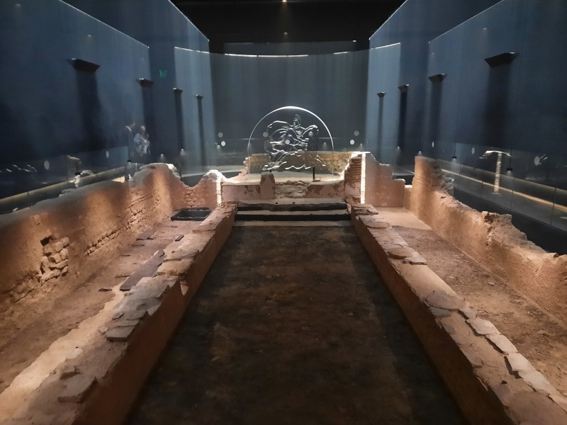
Mithraeum Museum
https://livinglondonhistory.com/london-mithraeum-a-hidden-roman-temple-under-the-city/
Notes:
Jonah

Slide 4
About me
What do I do?
An evolutionary basis to belief in conspiracy theories:
Introduction
Recently fascinated with history of old computational techniques
Study the past to inform the future
“Archaeology” of algorithms/historical reconstruction of algorithms
Unconventional approaches to AI
Motivation
We should try to learn from the past
AI has had multiple winters
Another AI winter?
Deep learning may (or may not) saturate at some point
Attempt a synthesis of classical approaches with modern ones
Notes:
Jonah

Slide 5
About the project
Introduction
Jonah Miller: Part 3 Student in Cambridge
Reconstructed a heuristic-based/classical AI algorithm multiple versions from scratch
Implemented in Python
Motivation
Part of his thesis
Taught himself computer science in the process (Math major)
Interested in seeing if computers can solve problems in mathematics/physics
Notes:
Jonah

Slide 6
Introduction to the Problem
Introduction and Motivation
An evolutionary basis to belief in conspiracy theories:
Introduction
Computational Scientific Discovery (CSD) finds patterns and invariants in datasets using computers.
Classical AI methods/heuristic based methods – which pioneered the space in the 1980s’ – have been largely forgotten.
Recent research has been done using deep neural networks (DNNs).
Motivation
The programs used in the 1980s’ had to be optimised and efficient to run on the computers of the time.
Classical AI programs are explainable and reproducible, not the case with modern day DNNs.
Classical programs are significantly faster as they have no training time.
Notes:
Jonah

Slide 7
Background
An evolutionary basis to belief in conspiracy theories:
Classical AI and Explainable AI
Classical AI
Deterministic and reproducible.
Output is interpretable and clear based on the programmed logics.
Explainable AI
Modern DNNs have outputs that may not be understandable
Can lead to serious consequences such as discriminatory models or medical misdiagnoses.
Explainable models are trustworthy and worth the goodness-of-fit sacrifice.
Notes:
Jonah

Slide 8
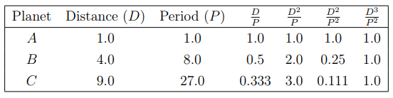
Background
An evolutionary basis to belief in conspiracy theories:
The BACON System
BACON is the Classical AI program used.
It is explainable and understandable (and elegant!)
Uses simple heuristic to find invariants between two variables.
For two variables X and Y if they increase/decrease together then divide them. Otherwise consider their product.
Notes:
Jonah

Slide 9
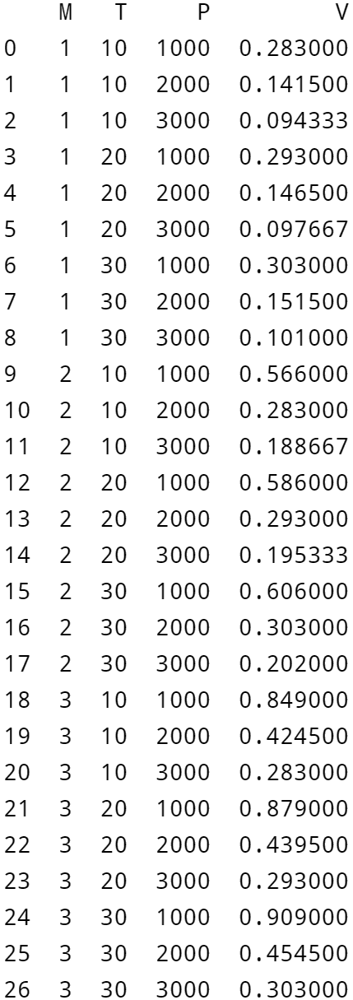
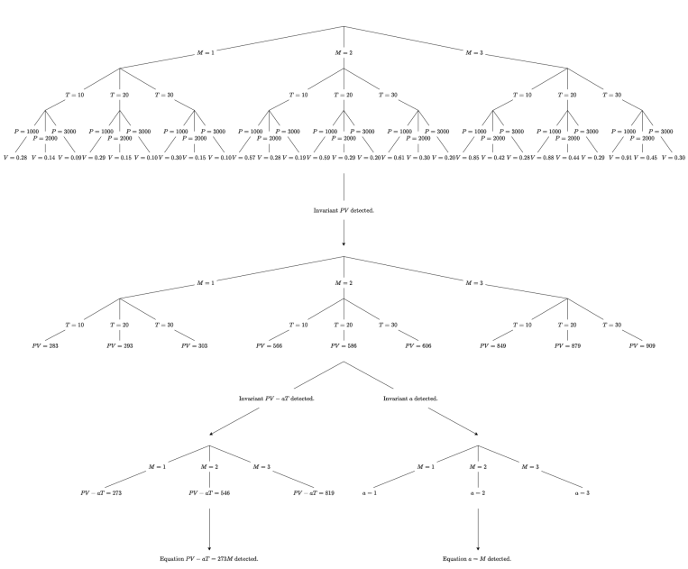
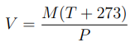
The BACON System - Multivariable
Notes:
Jonah

Slide 10
Relevant Works
PySR
An evolutionary basis to belief in conspiracy theories:
Modern day method, uses symbolic regression on a graphical neural network.
More powerful than BACON, can solve differential equations and find invariants in discontinuous environments.
Biases coefficients towards simplistic values.
Notes:
Jonah

Slide 11
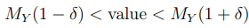
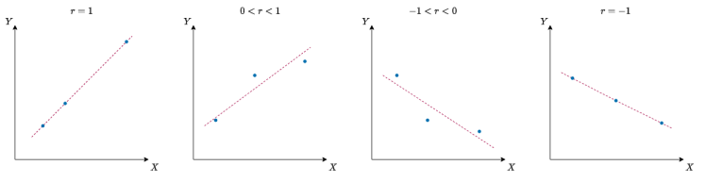
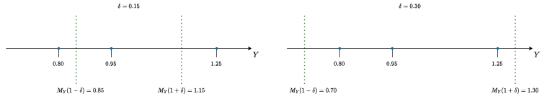
Method
BACON.1
An evolutionary basis to belief in conspiracy theories:
Linearity check:
Uses correlation coefficient r between variables X and Y.
Invariant check:
Checks if each value of the dataset satisfies
Notes:
Fredrik

Slide 12
The BACON System - Multivariable
Noise
Notes:
Jonah

Slide 13
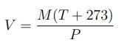
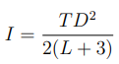
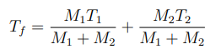
Results
An evolutionary basis to belief in conspiracy theories:
Datasets
Our full reconstruction of BACON (we call it BACON.7) was tested on 3 datasets.
Each dataset had up to 4% noise added to the dependent variable.
BACON.7 and PySR formed predictions on the datasets equation after being handed this noisy data.
The aim was to find the correct form of the equation.
The Ideal Gas Law:
Ohm’s Law:
Black’s Law:

Slide 14
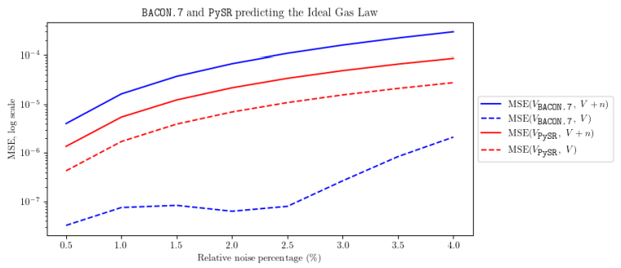
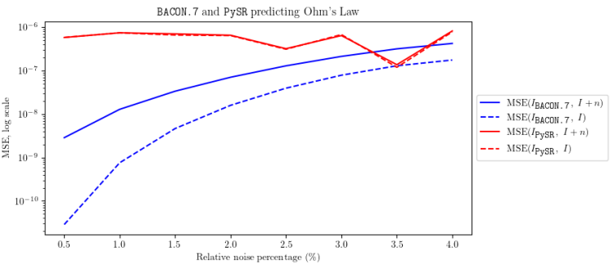
Results
An evolutionary basis to belief in conspiracy theories:
The Ideal Gas Law and Ohm’s Law (27 datapoints)
B
BACON finds the true equation an order of magnitude more accurately than PySR (if there is no noise).
PySR can’t deduce the correct form of the equation.
BACON again finds the true equation more accurately than PySR’s best prediction.

Slide 15
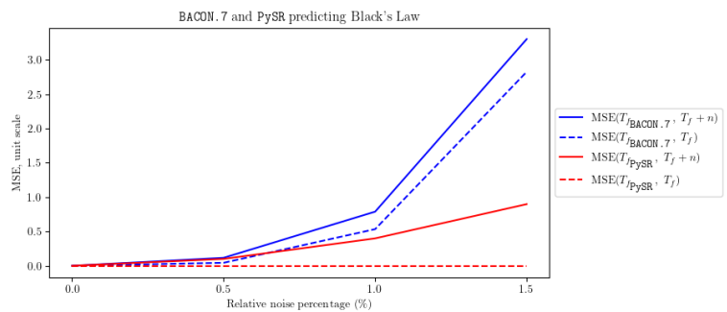
Results
An evolutionary basis to belief in conspiracy theories:
Black’s Law (81 datapoints)
PySR finds the perfect equation on Black’s Law regardless of noise.
BACON cannot handle 2% noise.

Slide 16
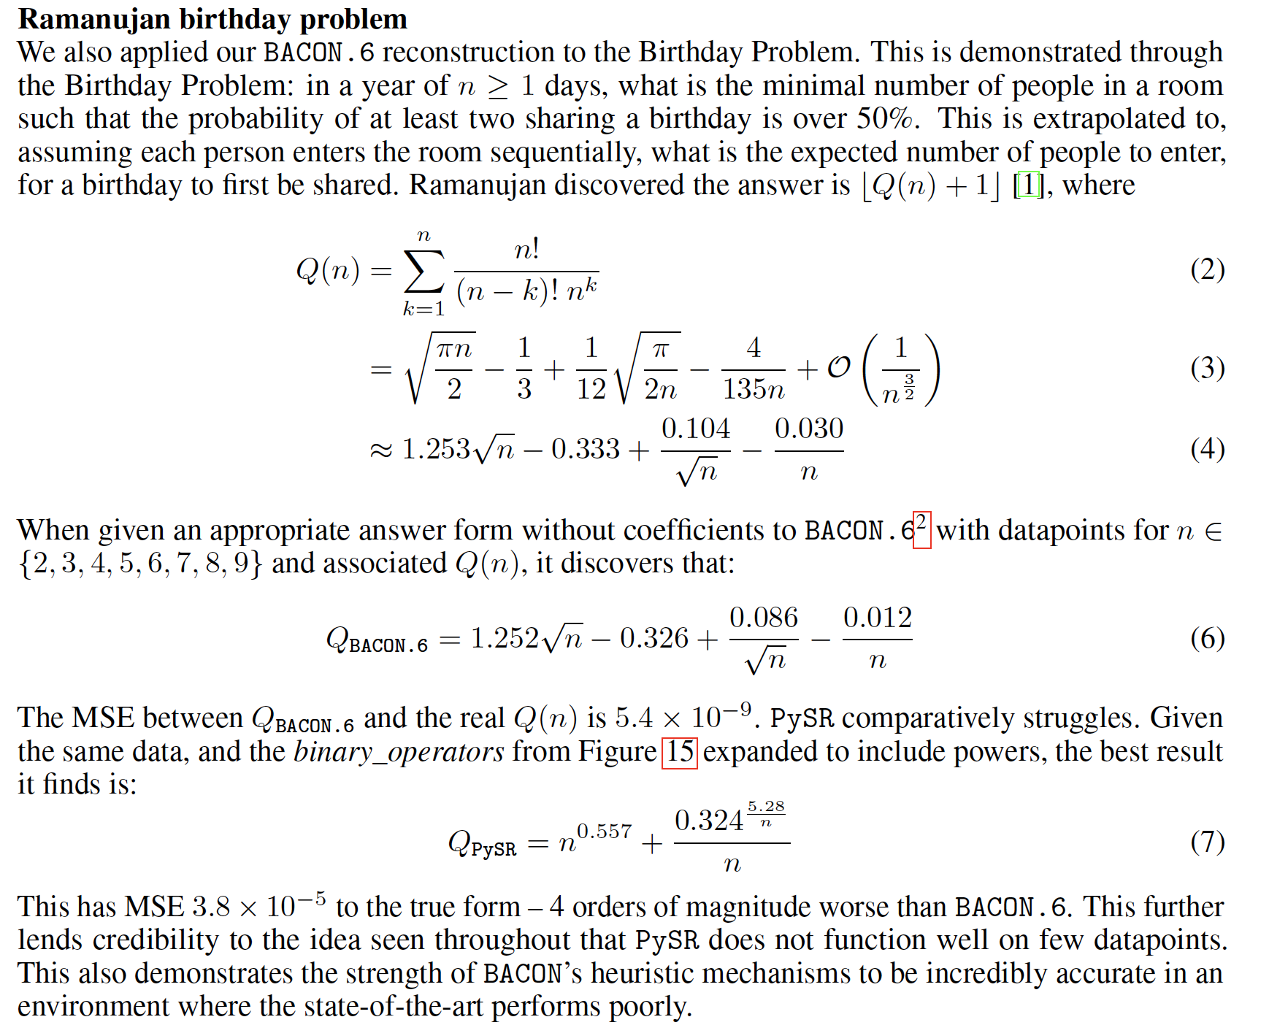

Ramanujan’s approximation

Slide 17
Conclusion
An evolutionary basis to belief in conspiracy theories:
Limitations and Future Directions
1980s’ papers.
Written full of dense code in antiquated languages, papers meant for people already knowledgeable with the sector.
No open-source code in modern languages.
Hard to compare to other projects in the area due to the lack of modern implementations.
For some smaller datasets, BACON can thrive whilst PySR struggles
Combine modern DNNs with Classical approaches to get powerful models which are more explainable.
For example, can add dimensional analysis in BACON to choose the correct equation when datasets are noisy.
Notes:
Fredrik

Slide 18
Summary
1
This project aimed to prove that Classical and Explainable approaches can improve Computational Scientific Discovery.
2
It did this by recreating the understandable BACON. Results displayed BACON was sometimes more accurate than modern PySR on smaller datasets.
3
Future directions involve combining these approaches with modern methods. Code released open-source to aid development in the area.
Notes:
Guillem

Slide 19
Next Steps
1
There may be scenarios where classical AI/heuristic-based methods can perform better than modern techniques
2
A fruitful next step would be to create hybrid systems that combine classical AI techniques with deep learning (e.g., large-language models)
3
Active learning: actively probe and acquire data
Notes:
Guillem

Slide 20
Learnings
1
Study classical AI systems
2
A lot can be learnt by re-implementing them in modern programming languages
3
A lot can be learnt by studying these seemingly anachronistic systems
Notes:
Guillem

Slide 21
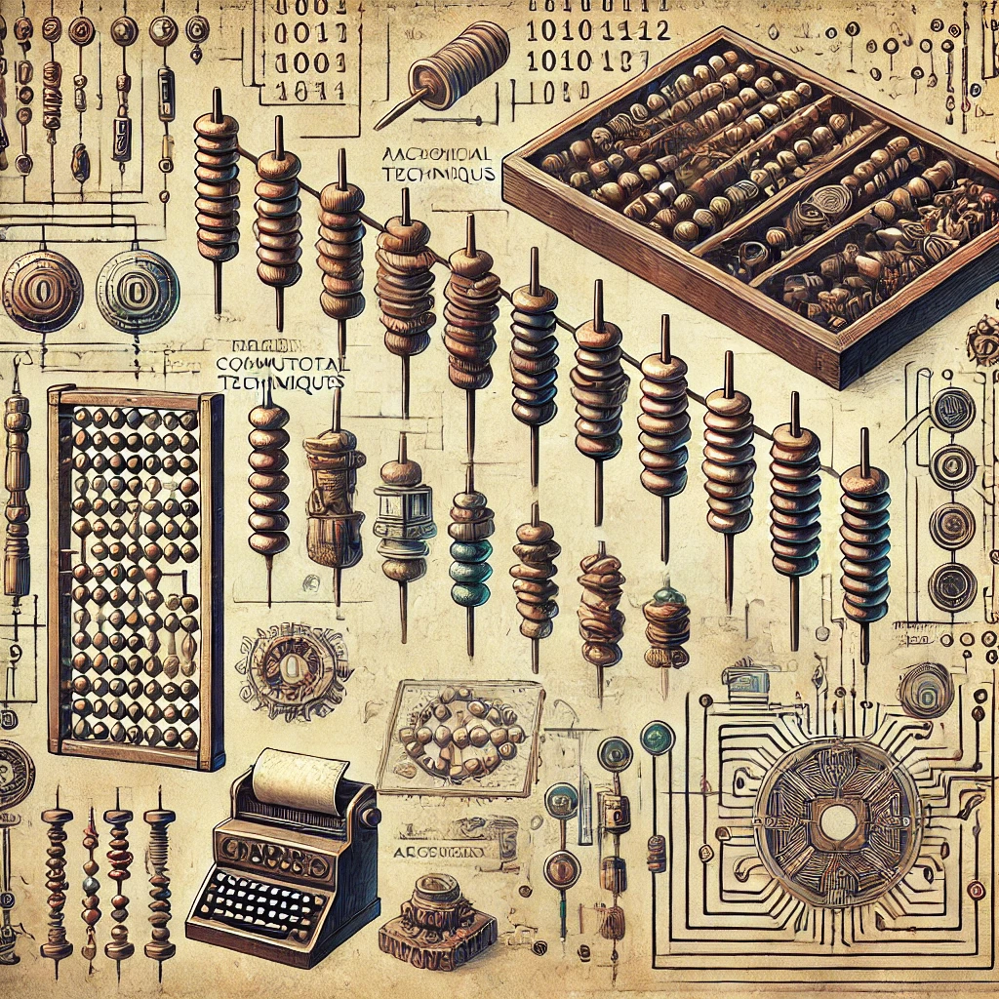
Learnings
Created using ChatGPT
Notes:
Sobering thought: need to learn from the past. There are veterans here in the audience who have been through multiple AI winters. We need to learn from the past so that we can delay/prevent the next AI winter.

Slide 22
Code and Preprint
https://github.com/JonahMiller/BACON
https://osf.io/preprints/osf/z8kqv
neel.soumya@gmail.com
Notes:
Ready for integration into your pipelines! Fork away!

Slide 23
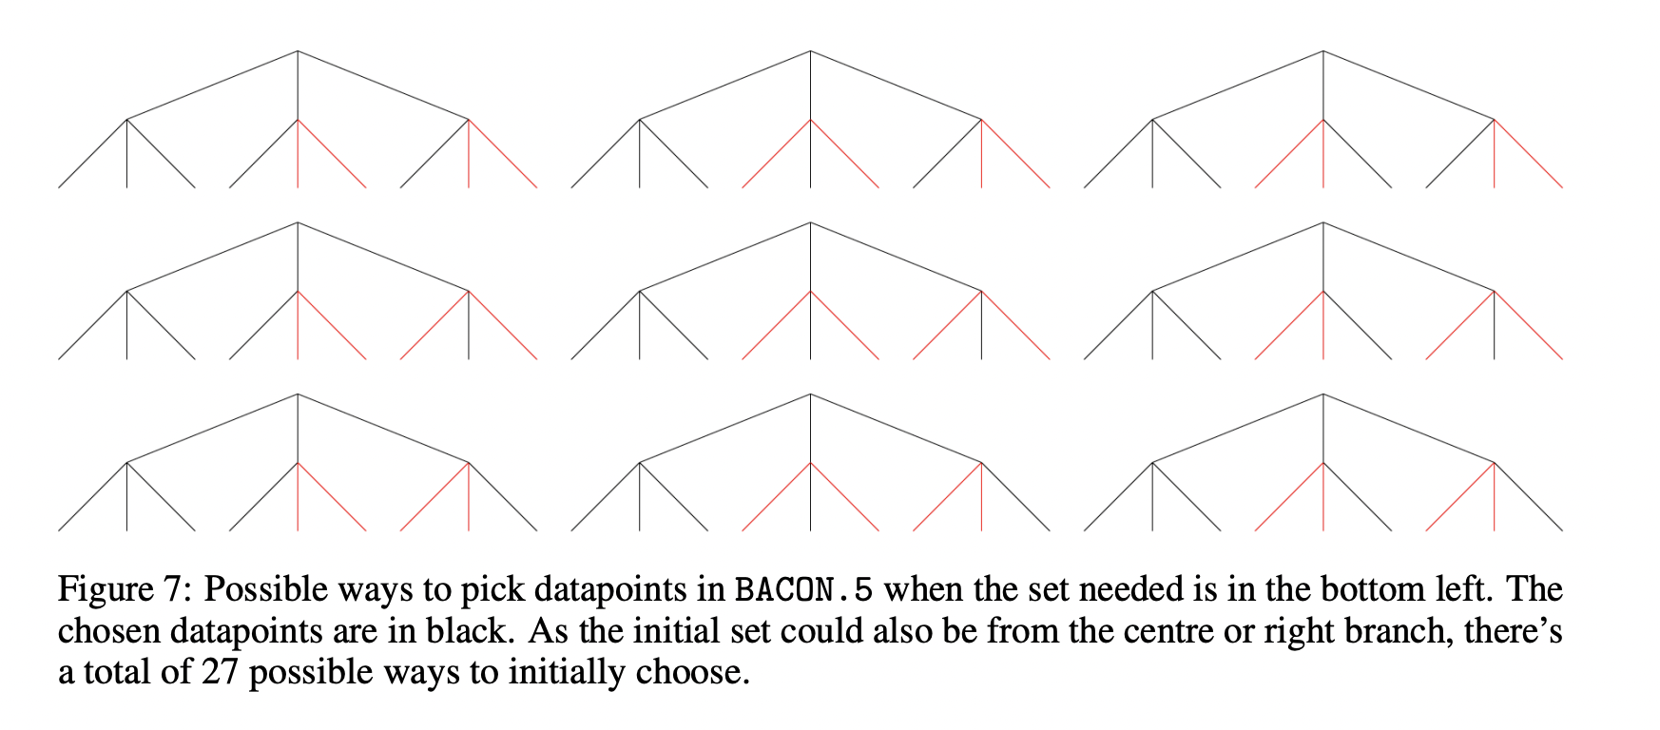
The BACON System - Multivariable
Noise
Notes:
Jonah

Slide 24
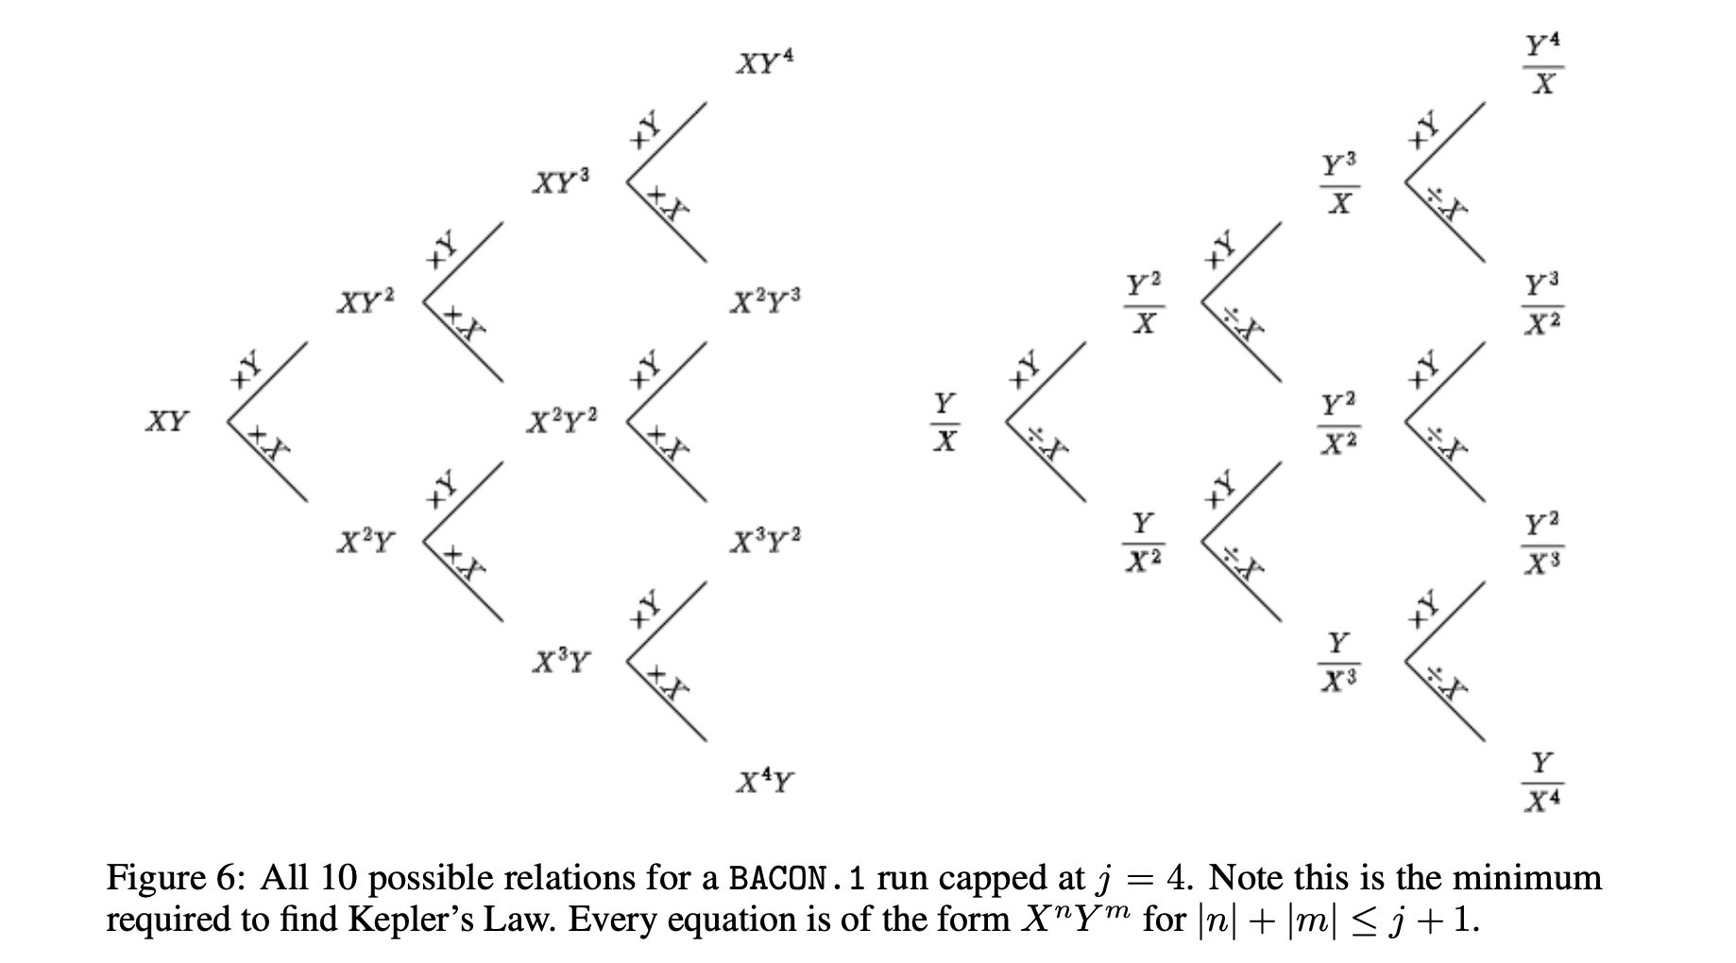
The BACON System - Multivariable
Noise
Notes:
Jonah

Slide 25
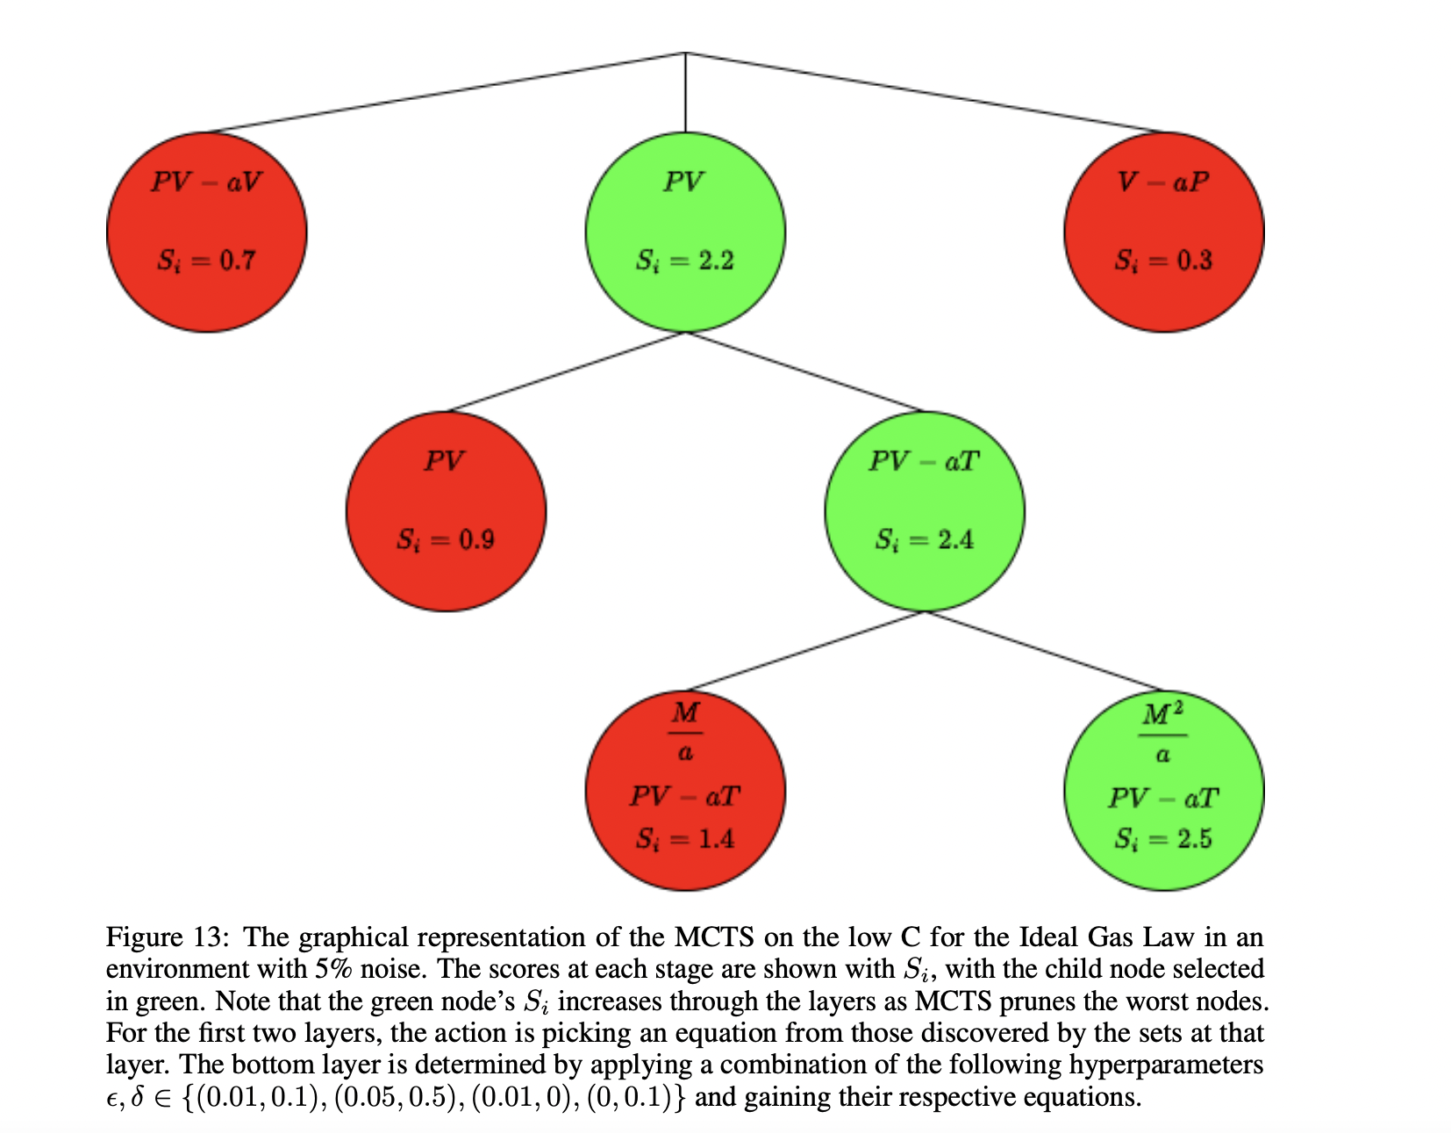
Monte Carlo Tree Search
Notes:
this suggests that MCTS is not the correct adaptation for BACON as the right reward function is very hard to find, if it does exist at all.

Slide 26
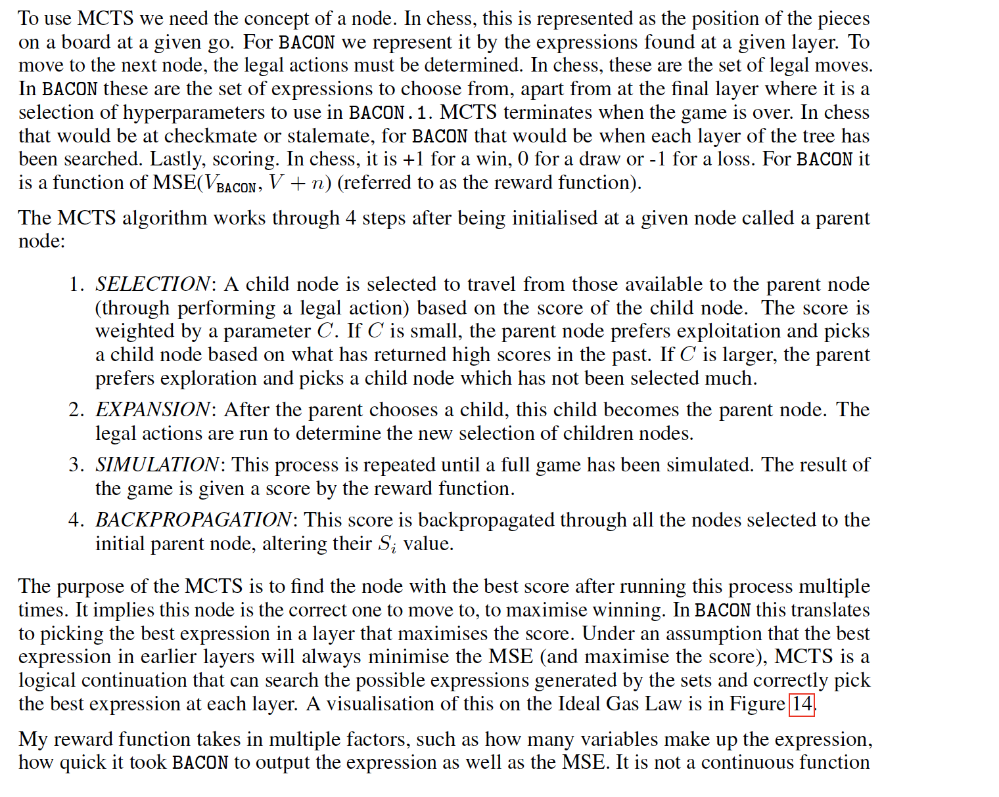
Notes:
Jonah

